Slide 1

B.Tech (IT) Minor Project Presentation 2022 Financial Management System
Presented by: Piyush Katyayan
Seli Sinha
Manash Pratim Deori
Kaushik Saikia
Under the supervision of Dr. K. Amitabh
Department of Information Technology
North-Eastern Hill University

Slide 2
Outline
Problem Statement
Motivation
Introduction – Android OS
Working
Architecture
ER Diagram
Working
Timeline – Gantt Chart
Progress
Summary
References
Continuation

Slide 3
Problem Statement
Android application for financial management and expense tracking of the user.

Slide 4
Motivation
Experience & Motive
As a student who has to depend on his guardians for pocket-money, I can say money management is hard. We need something to track our expenditure process, but it’s a “24 x 7” job.
AS WE NEED SOMETHING THAT STICKS WITH US AND WE CAN LOOK UPTO DAILY, NOTHING COMES TO OUR MIND OTHER THAN HAVING AN APPLICATION RIGHT ON OUR PHONE!
Goal
To create a financial management application, designed to assist us in keeping track of our spending.
It can maintain transactional records and monitor for any changes in the spending.

Slide 5
Introduction – Android OS
Android OS is a Linux-based mobile operating system that primarily runs on smartphones and tablets.
It also includes a GUI, a web browser and end-user applications that can be downloaded.
Android was released under open source license, this allows for many variations of the OS to be developed for other devices, such as gaming consoles and digital cameras.

Slide 6
Working
As part of personal financial journal, users enter the amount and the item they are spending money on, the software automatically adjusts the balance as necessary.
The app can provide whole history of transactions by monitoring and managing the expenditures that includes basic needs (i.e. grocery items, medical bills etc.) and other extra items.

Slide 7
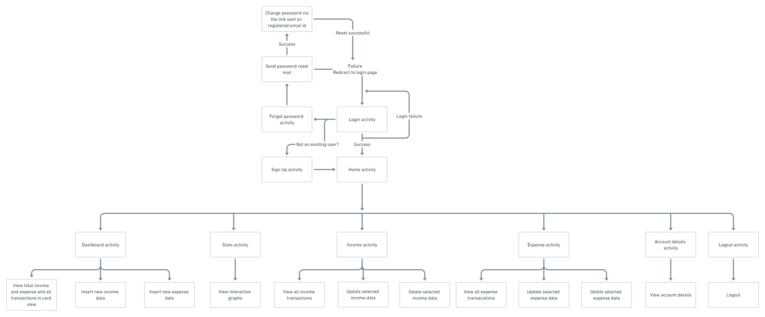
Architecture
->

Slide 8
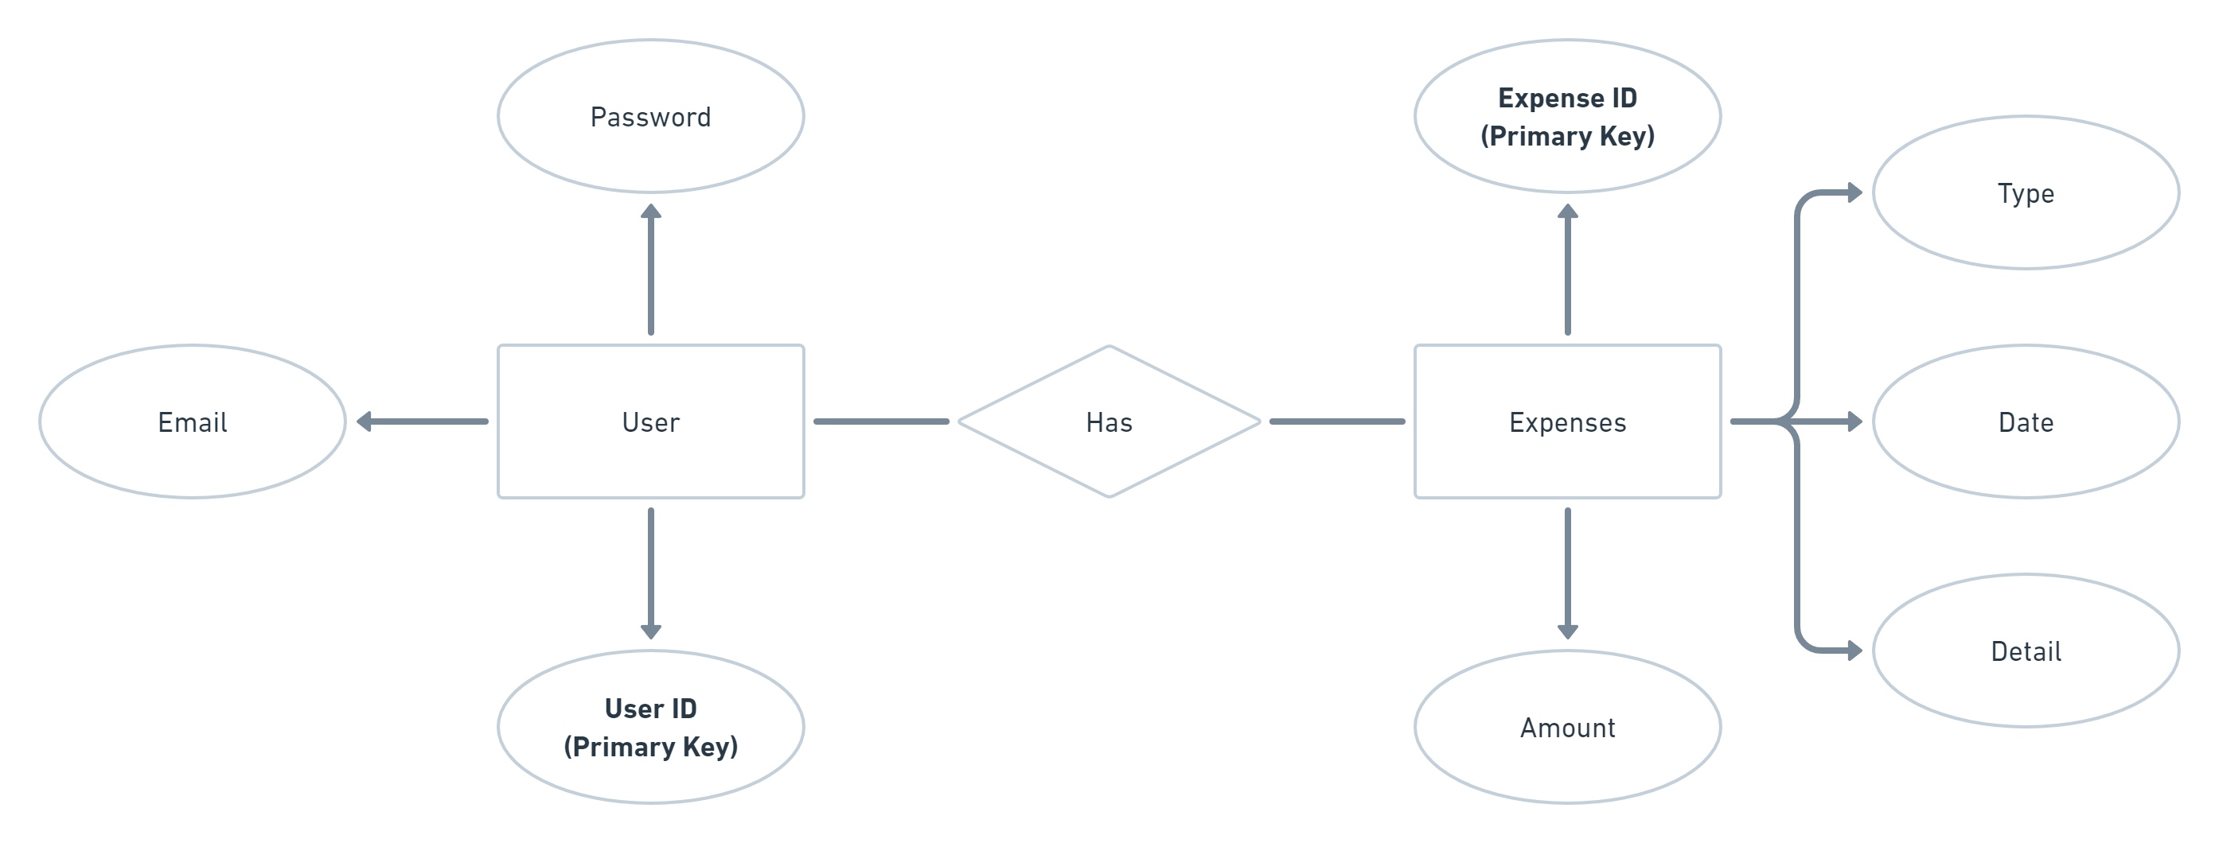
ER Diagram
->

Slide 9
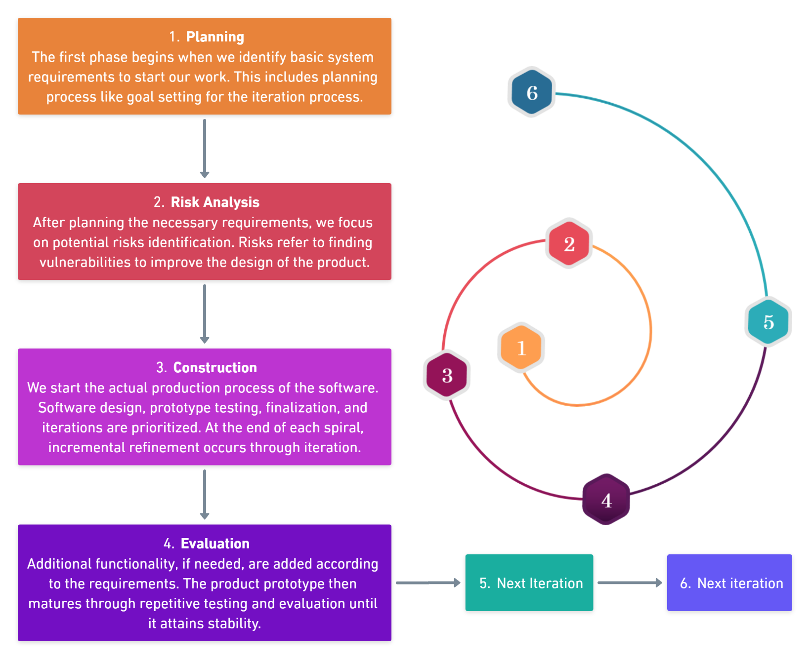
Working model
->

Slide 10
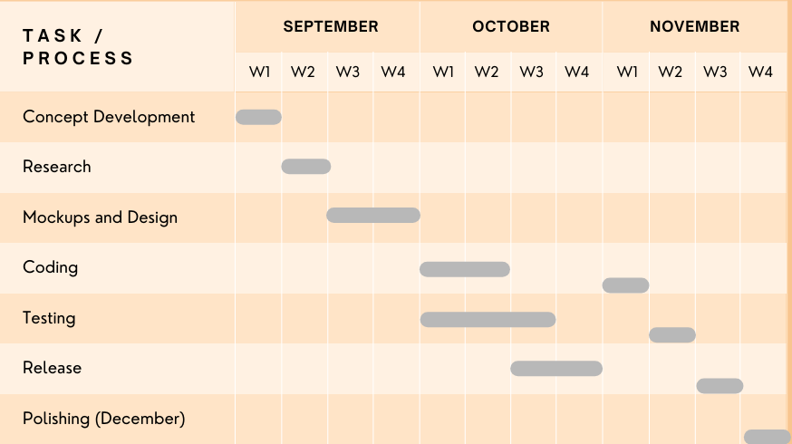
Timeline – Gantt Chart
->

Slide 11
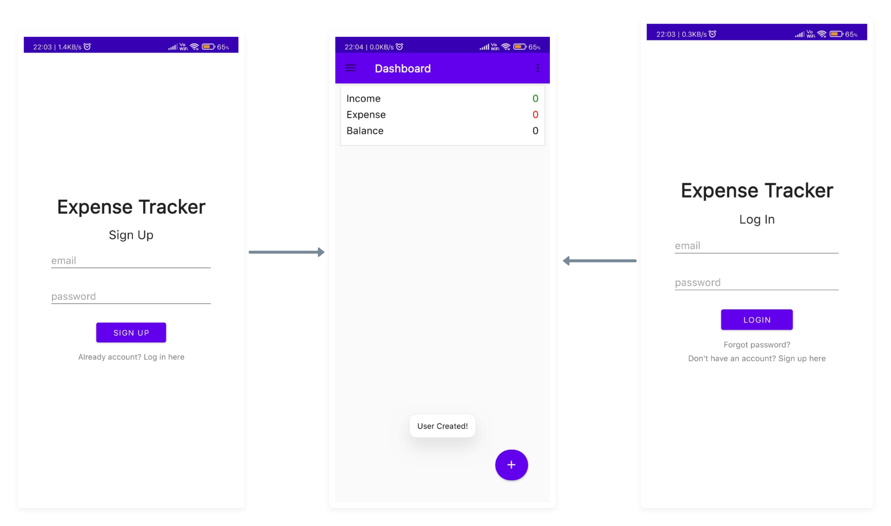
Progress…
User signs up/logs in.
User is introduced with empty dashboard initially.

Slide 12
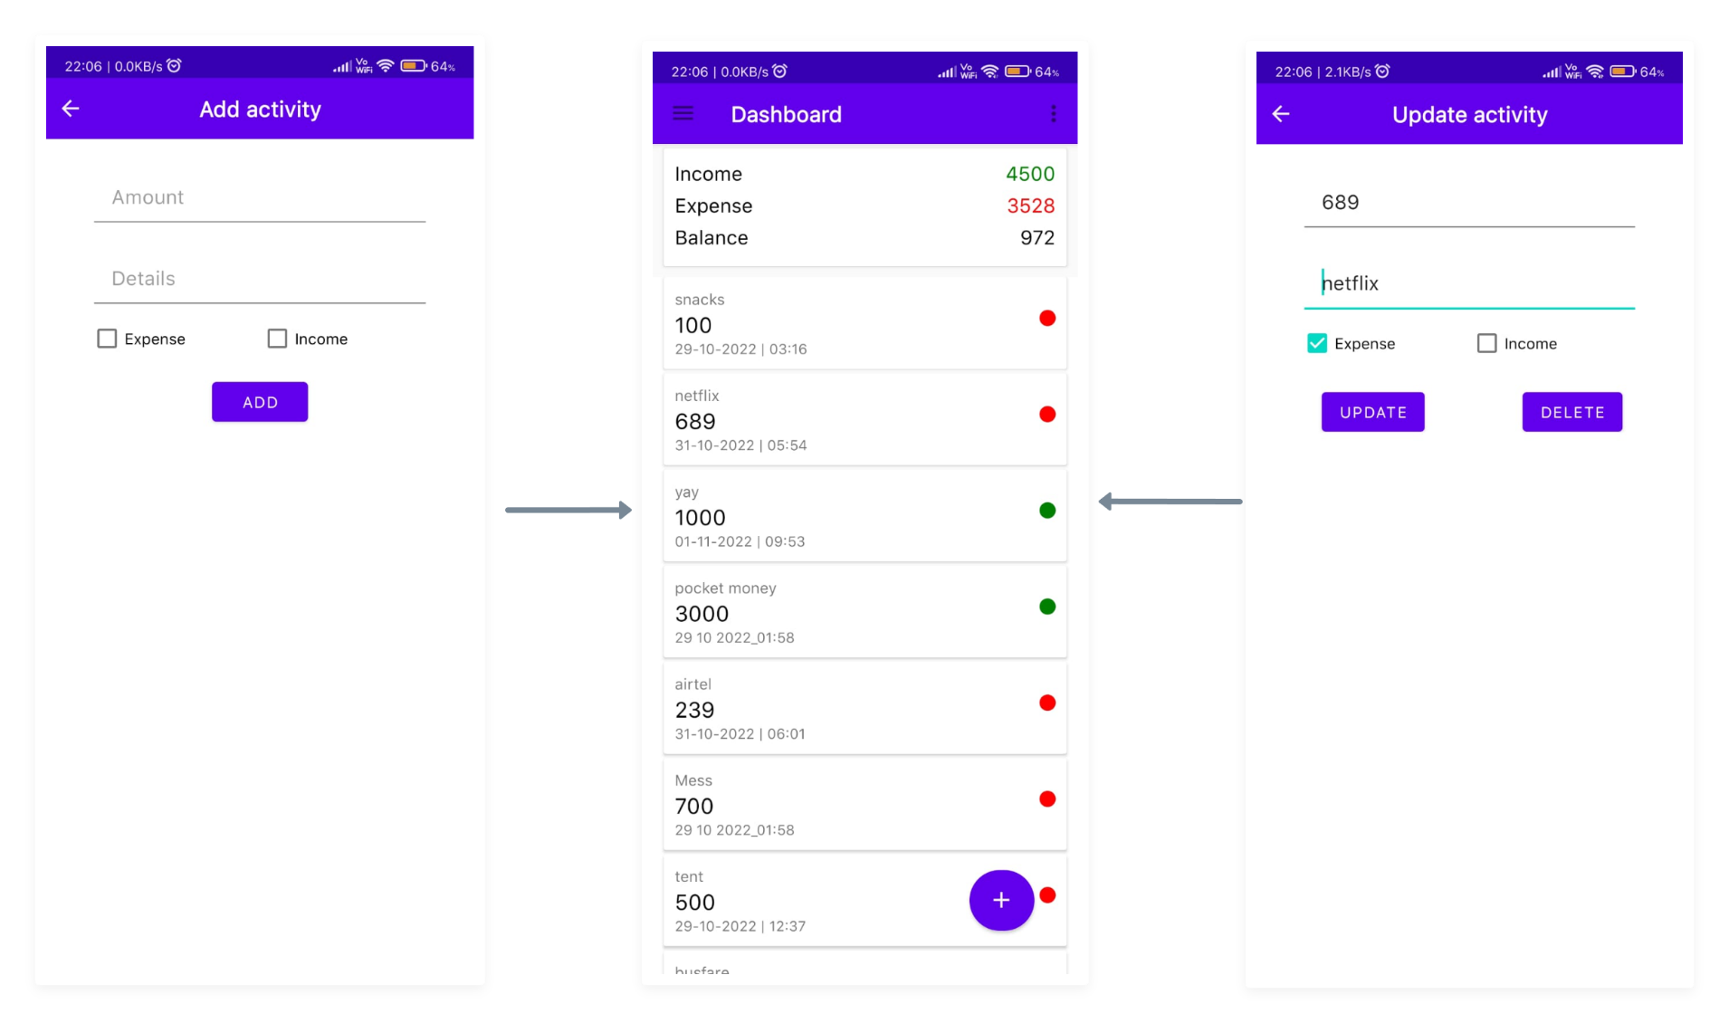
Progress
Users can input data (new), update the changes or delete the data.
Entered data will be reflected in the dashboard accordingly.

Slide 13
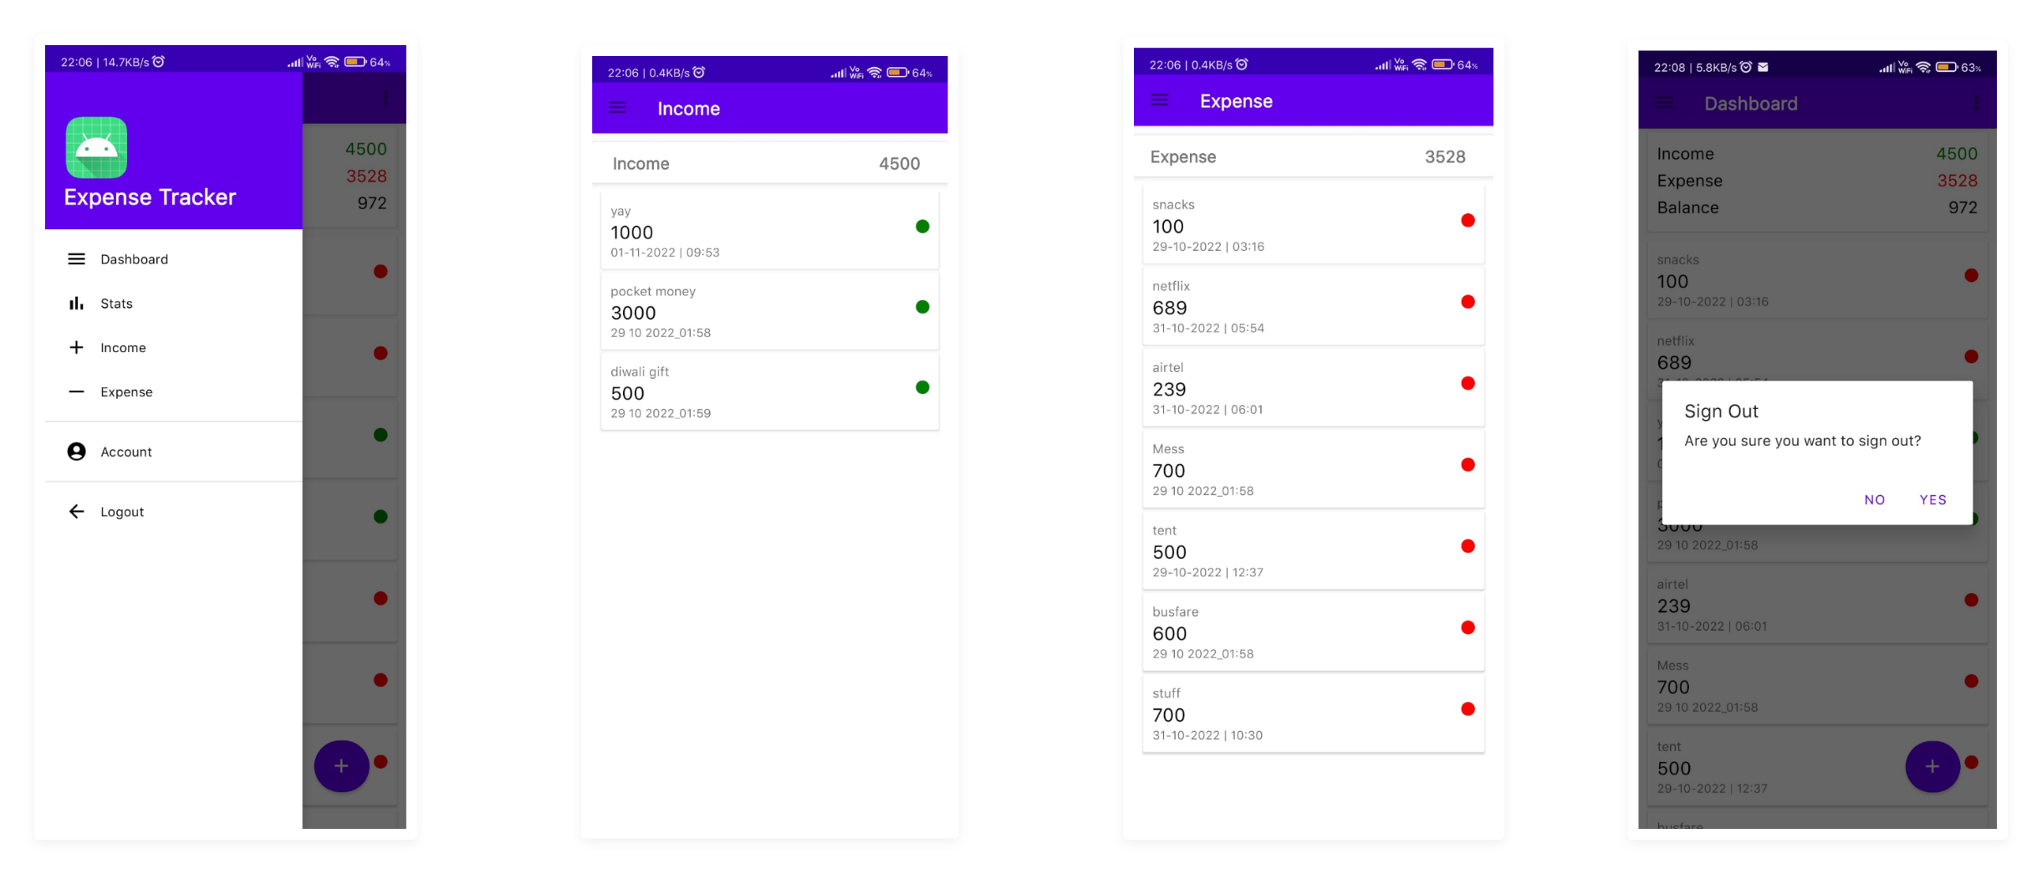
Progress
User can navigate into different activities.
Activities – Income and Expense.
User logs out.

Slide 14
Continuation…
Create a statistics activity that will display a graph of the income and expense curve.
The expansion of the account information activity.
Create a password-forget page.
Create menu options for erasing all data in the event that a user wants to do so.
Upgrade the app's user interface design.
Create the icon for the application.
Generate the alert feature if expense is increasing.

Slide 15
Summary
An application to track and keep an eye on our spending.
Users can use this program easily as it will be compatible with the majority of devices Android is the most popular operating system for mobile and other tiny devices.
The user will provide his account information, which will initially be saved for additional program functionality.
The work plan is represented by the spiral model.
This model indicates that development will occur more than once as adjustments are made.
It provides a future extension.

Slide 16
References
Introduction to Android
https://google-developer-training.github.io/android-developer-fundamentals-course-concepts-v2/unit-1-get-started/lesson-1-build-your-first-app/1-0-c-introduction-to-android/1-0-c-introduction-to-android.html
Android for developers
https://developer.android.com/
Android software development
https://en.m.wikipedia.org/wiki/Android_software_development

Slide 17
Thank
You

Slide 18
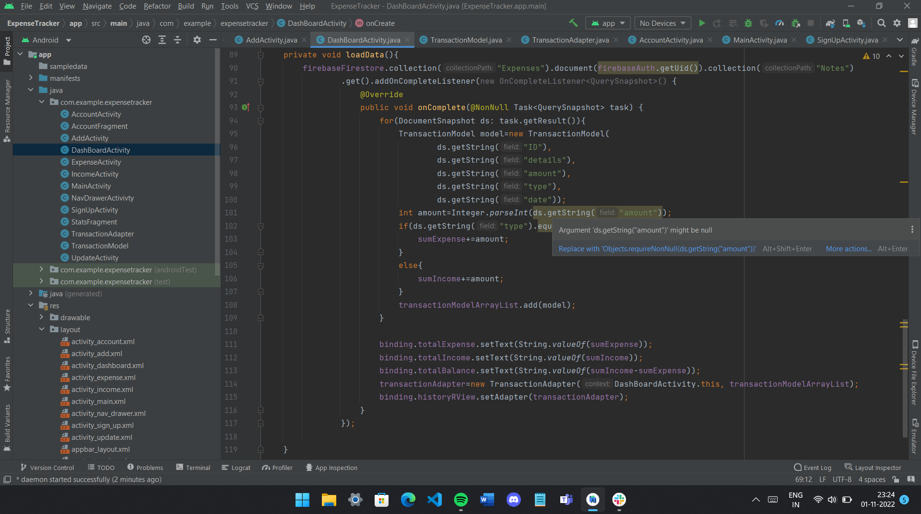
Code
Screenshot

Slide 19
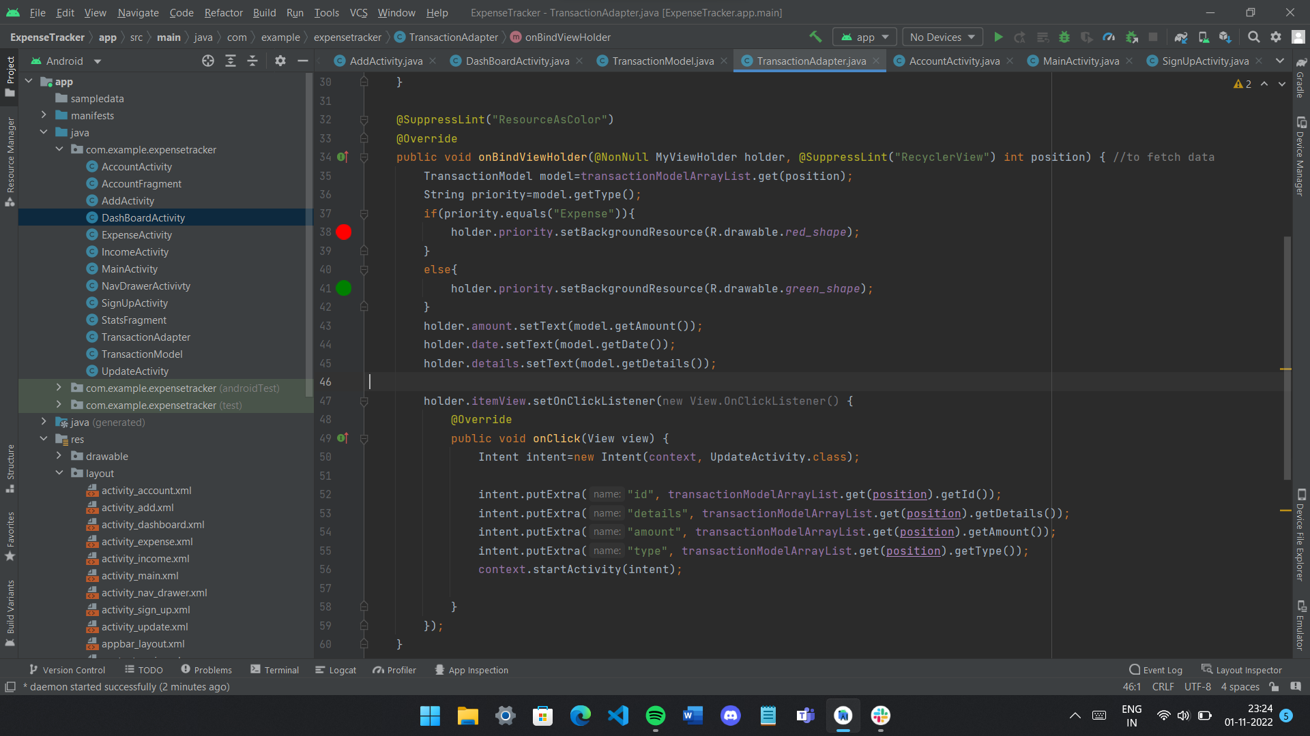
Code
Screenshot

Slide 20
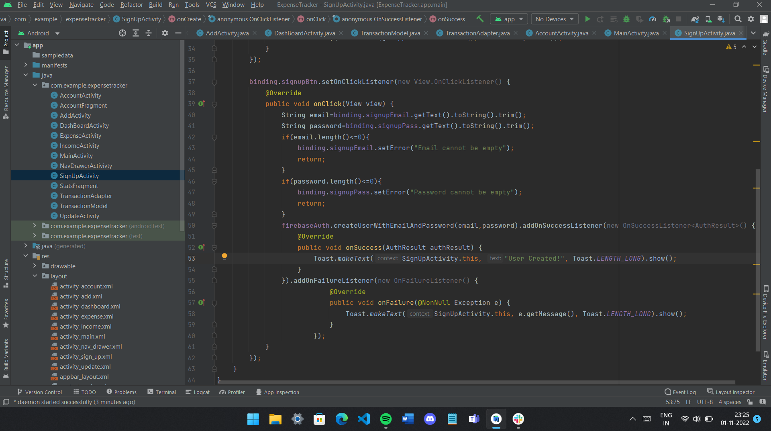
Code
Screenshot

Slide 21
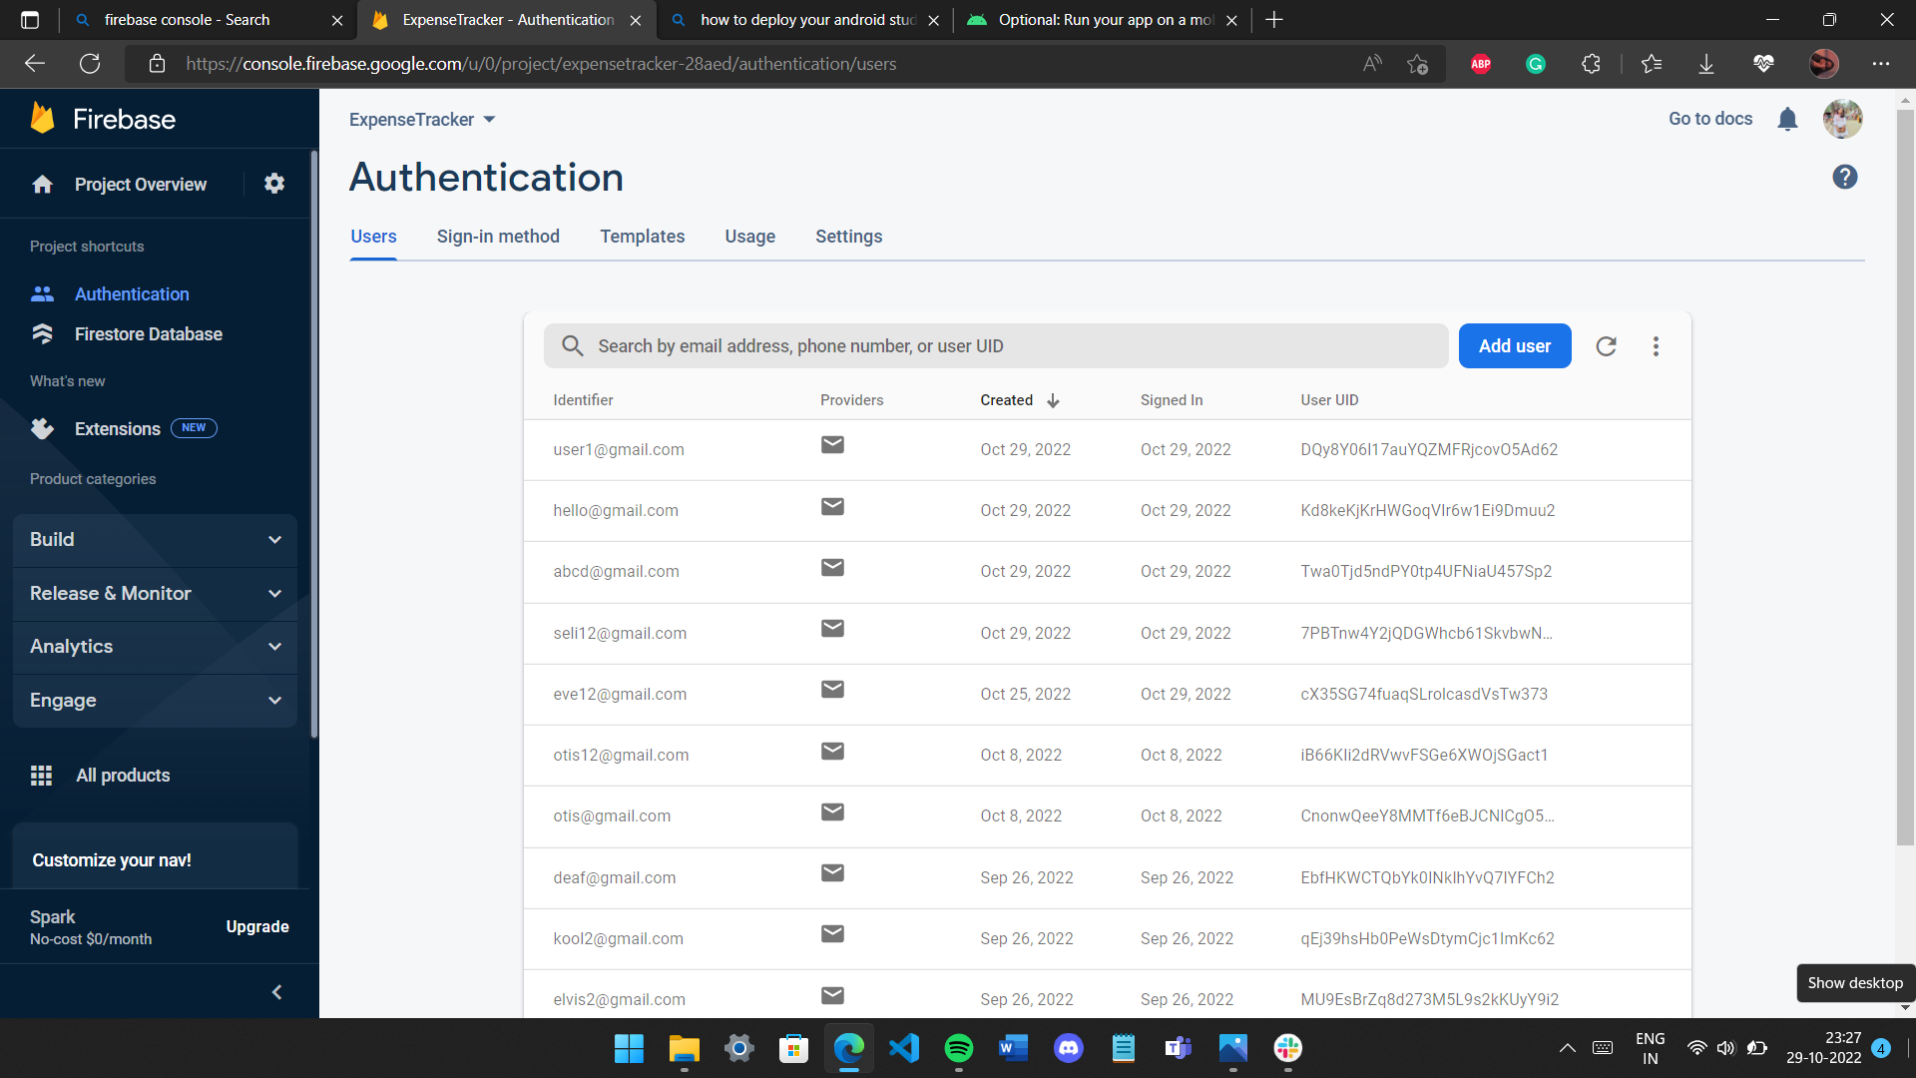
Firebase
Screenshot

Slide 22
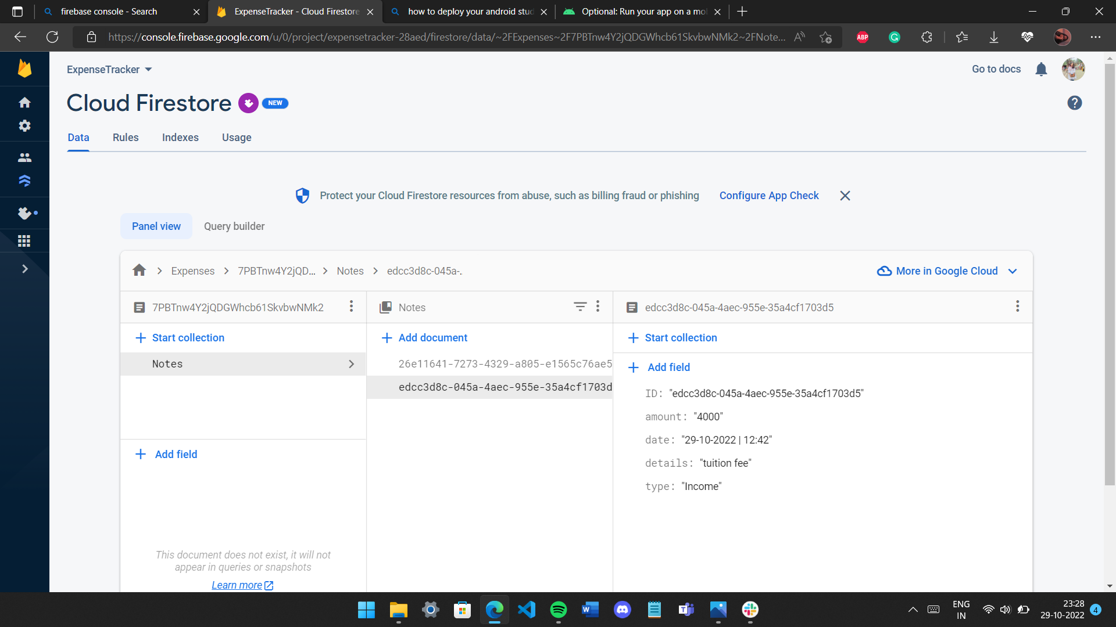
Firebase
Screenshot

Slide 23
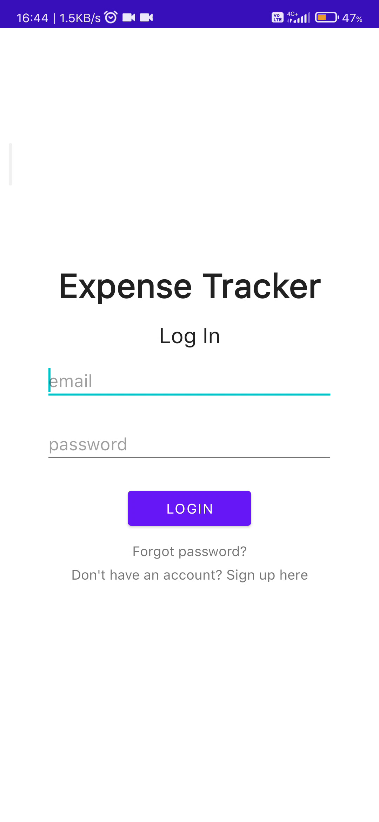
Video
Recording of working app

